Slide 1


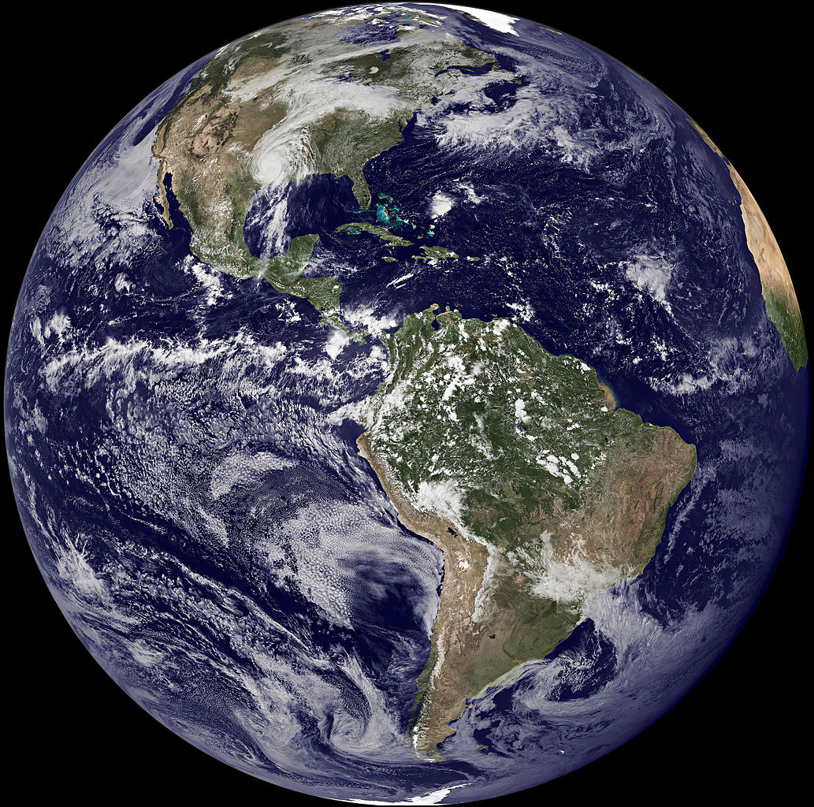








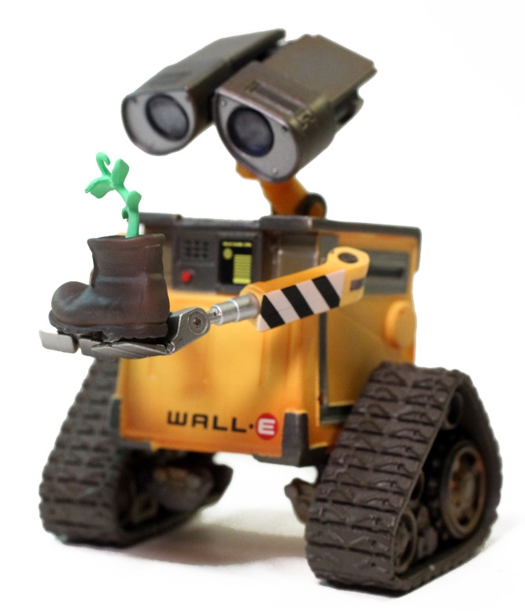


Science, Technology, Engineering, Math (STEM):
Environmental science and engineering, geosciences,
ecology, biology,
agricultural science,
data science, etc.
Liberal Arts
and Education:
Economics, public policy, law, history, arts, architecture, communication, education
Environmental Careers
Government & Policy
Develop and enforce policies (regulations, incentives) to
protect human health and the natural environment
Fund environmental research, education, and programs
Study environmental issues
and evaluate solutions
Design/plan green communities
(e.g., urban planning,
sustainable agriculture)
Career Fields
(What to major in?)
Job Sectors
(Where to contribute?)
Government & Policy
Examples:
Rachel Carson
(DDT, Silent Spring)
Marc Edwards
(Flint water crisis)
IPCC (climate
change)
Examples:
EPA, USGS, NOAA, USDA, etc.
Local agencies
Examples:
Erin Brockovich
Research & Academia
Produce new knowledge
Observe and explain
environmental problems
Evaluate risks or benefits of technologies and policies to
people and the planet
Develop solutions
Inform
policy
Educate
the public
Research & Academia
Law
Citizens
Environmental Law
Represent
environmental
interests in court
Advocate for
protection of
at-risk communities
(environmental justice)
Advise policymakers and clients on regulatory issues
Industry & Consulting
Non-Profits
Industry & Consulting
Develop and implement
environmental solutions
Produce green
products and energy
Reduce emissions
of pollutants
Remediate (clean
up) contaminated sites
Ensure regulations are met
Examples:
The Nature Conservancy
Sierra Club
Non-Profits
Analyze policies and solutions
Engage in conservation efforts
Advocate for people
and the environment
(e.g., comment on
proposed regulations)
Communicate environmental awareness to the public
Examples:
Renewable energy developers
Environmental consulting firms
Opportunities for Citizen Engagement
Economics
Use purchasing power
to encourage green products and practices
Politics
Express support for sustainable, science-based policies. Vote! ……
Volunteering
Participate in
“citizen science” and community service

